Slide 1
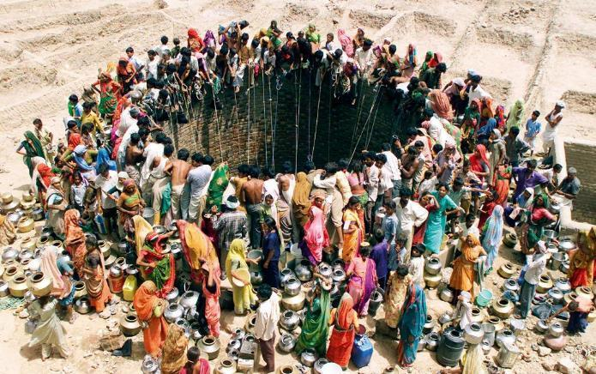
Sanitary Engineering for Development
Welcome - Bienvenue !
Dr. George Wainaina
For Vasco Schelbert
Eawag-Sandec
vasco.Schelbert@eawag.ch
Müller, Lanz, Rentsch und Schwarzenbach, “Wem gehört das Wasser?”

Slide 2
Course Overview

Slide 3
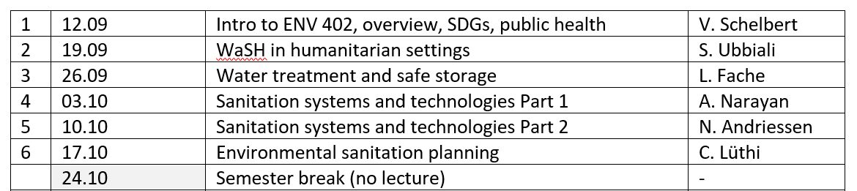
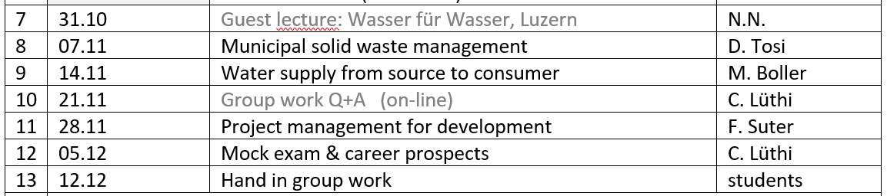
Lecture: every Thursday at 10:15
Group work: approx. 1 hour/week
Course Overview

Slide 4
Learning objectives
Overall
Know key issues of global WASH targets, trends and developments
1. Be familiar with water treatment options and promotion & marketing challenges
2. Understand key tools and methods for assessing human health aspects of WASH
Water
3. Understand the sanitation system chain and be familiar with typical solutions in each functional group
4. Understand the issues of faecal sludge management and be familiar with treatment solutions
Sanitation
5. Understand key challenges for planning/implementing basic services in rapidly growing urban areas
6. Understand the challenges and opportunities in municipal solid waste management
Solid Waste
Apply course knowledge: Analyze a case study assignment and provide realistic solutions for drinking water, sanitation and solid waste management
Group work

Slide 5
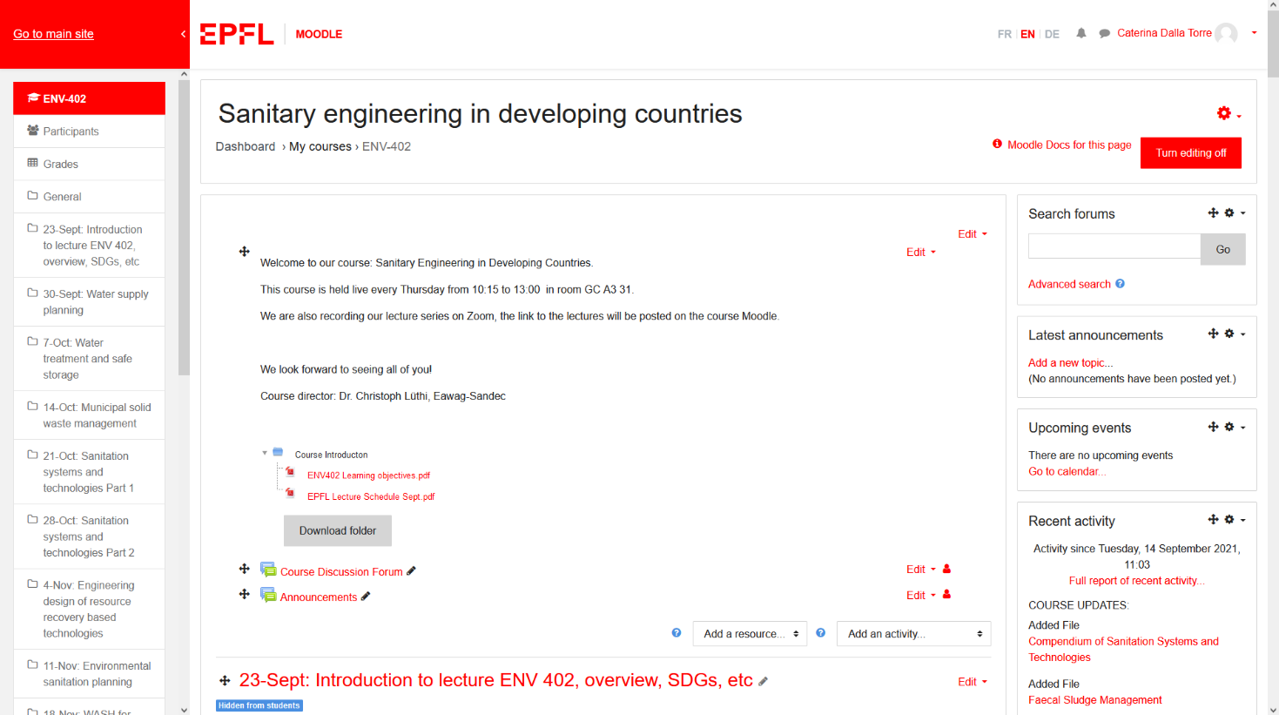
Use the course moodle!
Sanitary engineering for development

Slide 6
Part I – Introducing Sandec

Slide 7
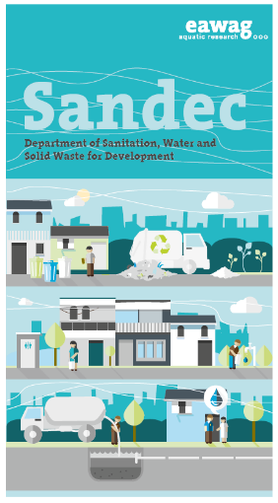
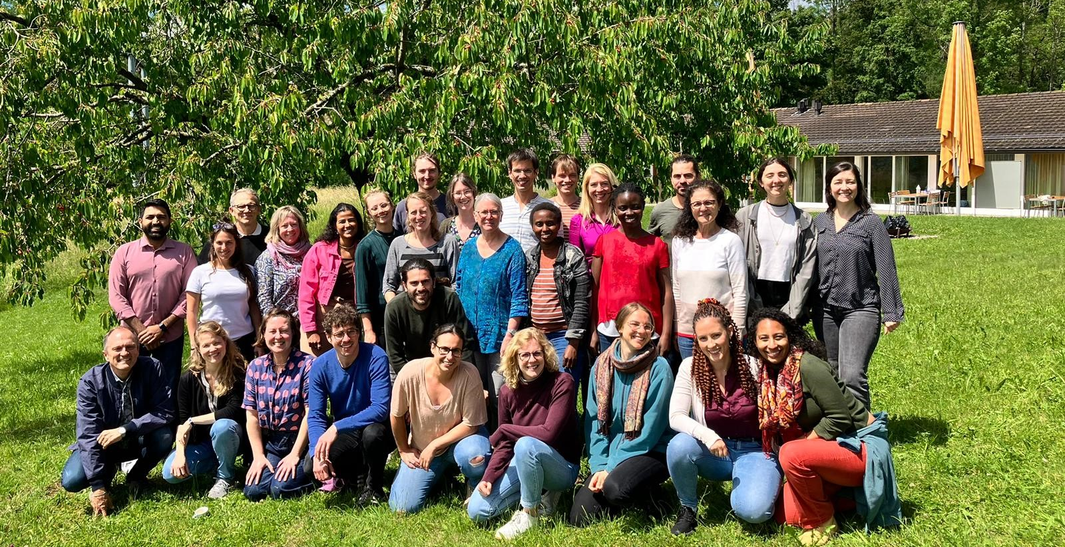
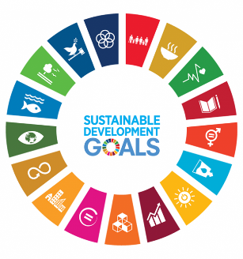
Introducing Sandec

Slide 8
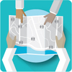

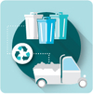
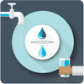

Eawag Department Sanitation for Development (Sandec)
Introducing Sandec
Our 5 research groups are
Strategic Environmental Sanitation Planning
Water Safety Management
Municipal Solid Waste Management
Management of Excreta, Wastewater and Sludge
Water Supply and Treatment

Slide 9










Our international partners

Slide 10
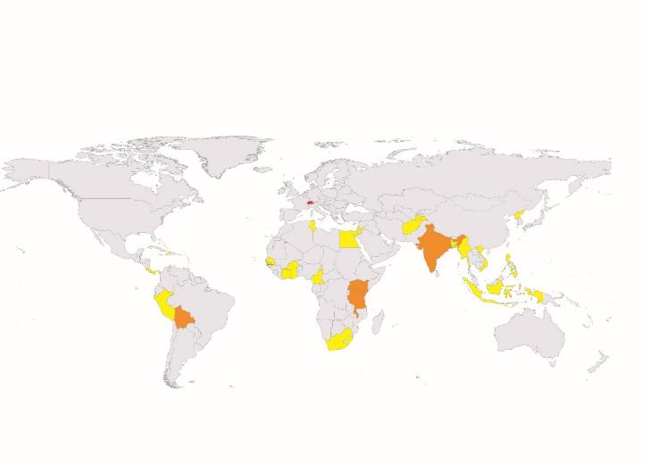
About me
Background: Social Sciences / Humanities
BA in Contemporary History & Philosophy
MSc in Sustainable Development
(MAS ETH in Spatial Planning ongoing)
Project Officer @ Eawag since 2017
QUISS > Shared Sanitation
ConCaD > Capacity Development
FACET > WASH Monitoring & Evaluation
Lighthouse > Decentralised Urban Water Reuse
Research projects in 10+ countries

Slide 11
Part I – Setting the Scene

Slide 12
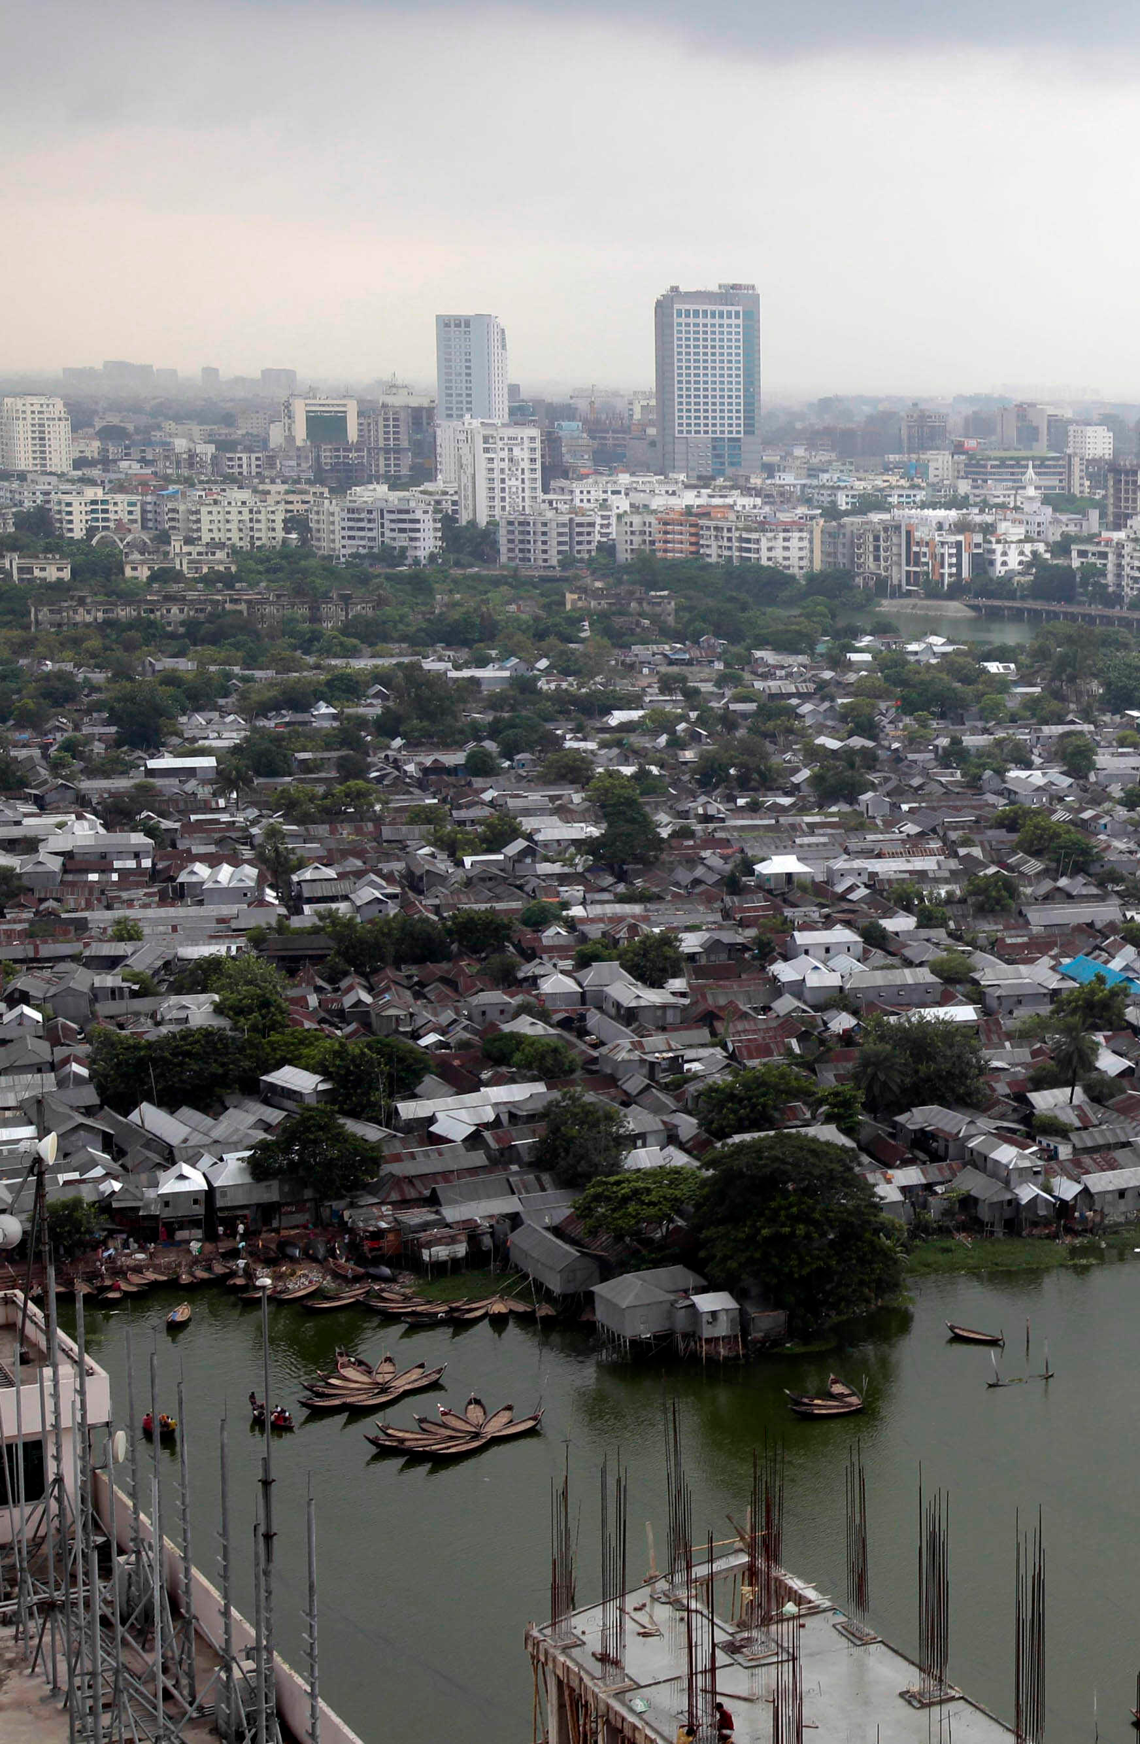
Rapid urbanisation
In 1950, 30% of the population lived in urban areas; today 56% (2024), with a projected 68% in 2050.
Rapid urbanisation means that households do not connect to the municipal system because they
…live outside the area served by the formal system;
…live in informal settlements and are denied connections to public services;
…are unable to pay service charges; or
…are unwilling to pay because they already have some form of e.g. sanitation.
Notes:
In 1950 only 30% of the worldwide population was urban; it is now 55% (2018) and growing, projected to be at 68% in 2050.
This rapid growth of cities means that the increase of people arriving in cities is higher than the capacities of cities to absorb them in terms of providing shelter and adequate access to basic services such as safe drinking water and adequate sanitation. This leads to people living in devastating conditions and leads to the building of informal settlements, also called slums.
[click]
Rapid urbanisation also means that households (HHs) do not connect to the municipal system because they
[click]
…live outside the area served by the formal system;
[click]
…live in illegal settlements and are denied connections to public services;
[click]
…are unable to pay service charges; or
[click]
…are unwilling to pay because they already have some form of sanitation.

Slide 13
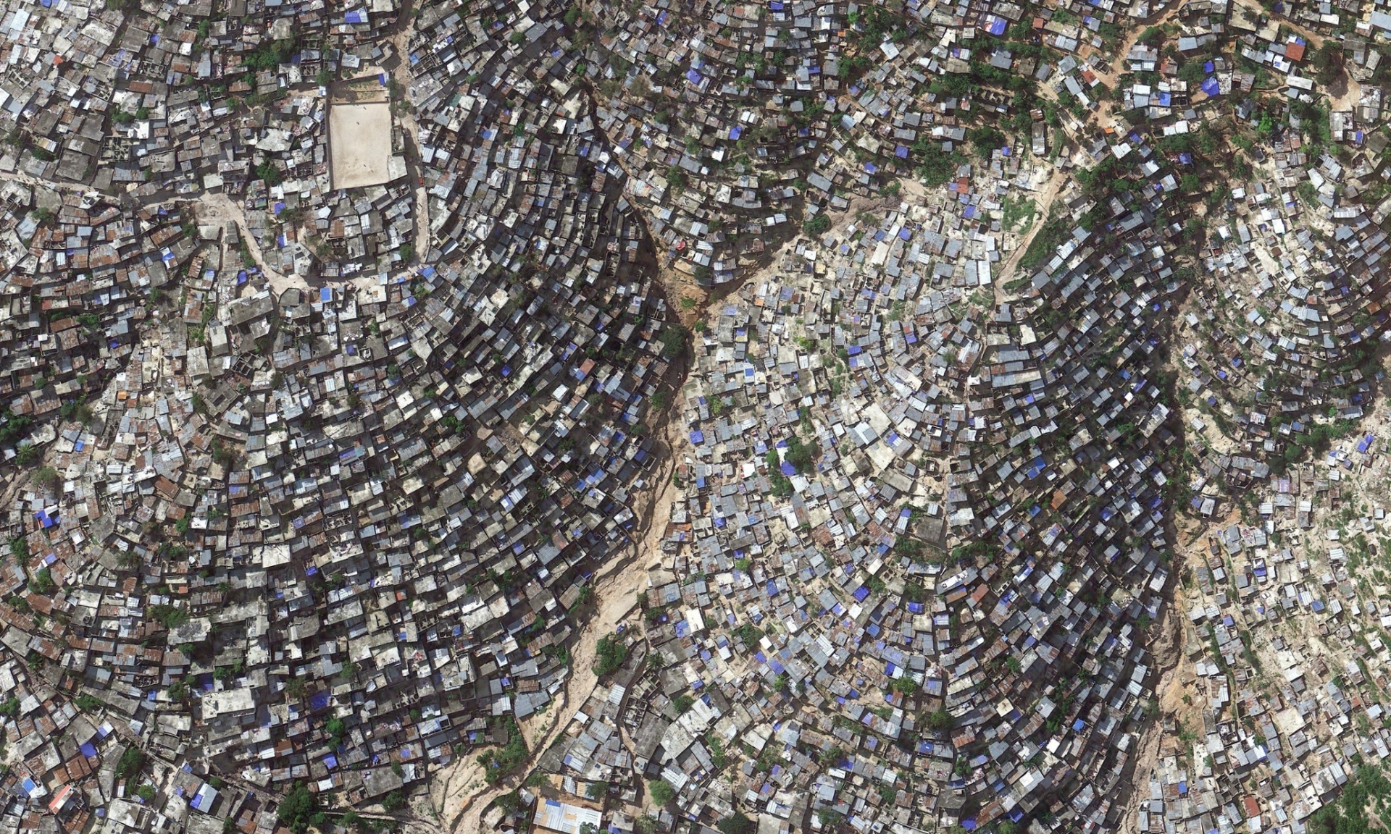
Low- and middle-income urban areas
Low-income (informal) settlements
Densely populated
High poverty levels
Notes:
These are the contexts where we as Sandec and our Strategic Environmental Sanitation Planning group are mostly active.
We work in urban development contexts, which usually are in urban areas and either formal or informal low-income settlements. Often, these contexts are characterised by high poverty levels and densely populated areas.
This means, there is hardly any space to build a sanitation system. Because poverty levels are high, people often cannot afford – or are not willing to pay – for sanitation services.
How do you establish adequate sanitation is such contexts?

Slide 14
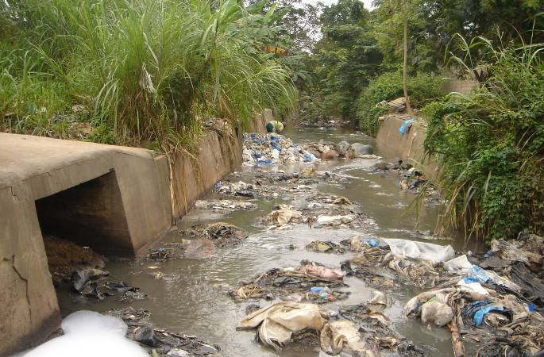
Low- and middle-income urban areas
Lack of (adequate) waste collection services
Lack of treatment plants
Discharge into environment
Notes:
These are the contexts where we as Sandec and our Strategic Environmental Sanitation Planning group are mostly active.
We work in urban development contexts, which usually are in urban areas and either formal or informal low-income settlements. Often, these contexts are characterised by high poverty levels and densely populated areas.
This means, there is hardly any space to build a sanitation system. Because poverty levels are high, people often cannot afford – or are not willing to pay – for sanitation services.
How do you establish adequate sanitation is such contexts?

Slide 15
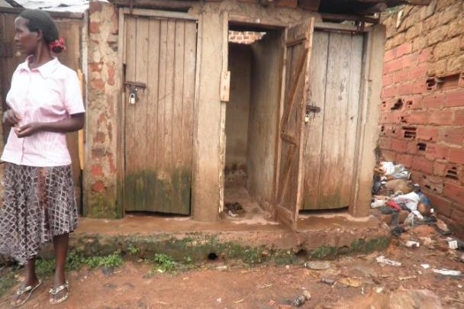
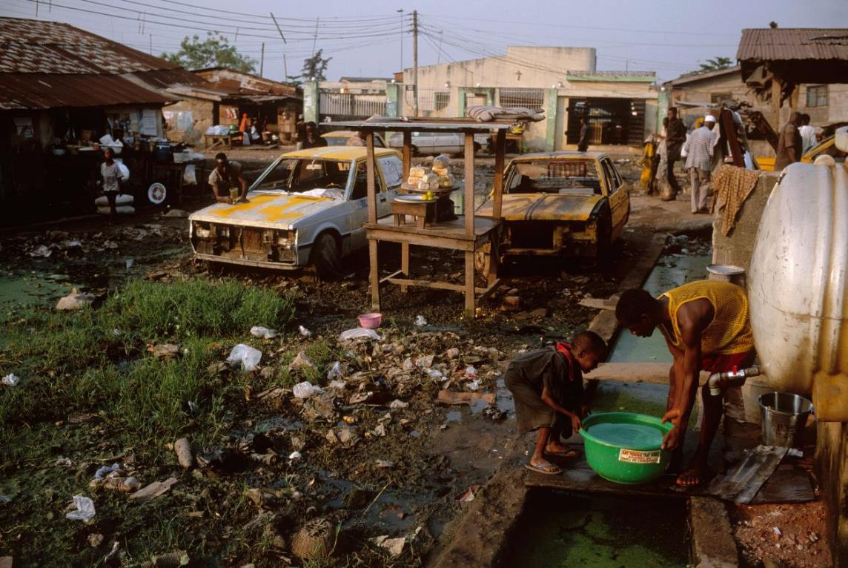
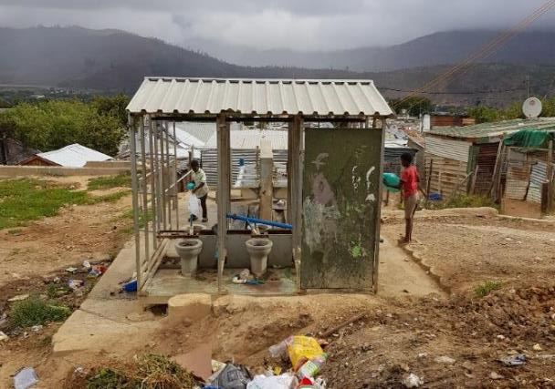
Informal settlement characteristics
Today ~1 billion slum dwellers
Substandard housing
No or insufficient access to services (water, sanitation, waste mgmt.)
Lack of tenure security
Many slum dwellers rent and do not own their structures

Slide 16
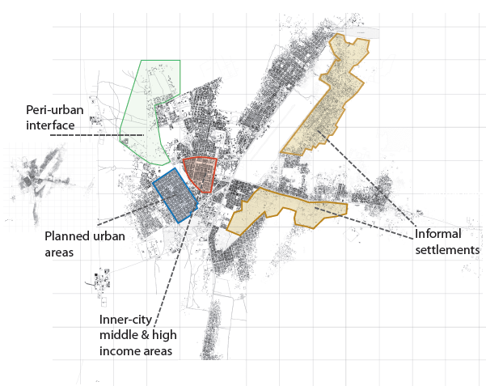
Sanitary engineering & contextual planning
Know the context, design from evidence
Cities and people are complex & dynamic
WASH services are context-dependent and must be socially accepted
There is a need for a range of service models, no one-size fits all solutions!

Slide 17
Sanitary engineering & contextual planning
Physical | Socio-cultural | Political, legal & institutional | Financial & economical: | Technical capacity
Climate (temperature, rainfall), soil (rock, sand...), groundwater, Water availability, Population density, | E.g. defecating posture (sitting/squatting), Anal cleansing material used (washers/wipers), Cultural gender aspects & privacy, taboos on handling waste | Regulations and standards, Organisational setup and responsibilities, Political will and support Bureaucracy | Affordable technology, Willingness to pay for appropriate service level, Availability of credits and loans | Availability of Local skills, Humanpower, Materials & tools, Financial resources Needed for sustainable operation & maintenance

Slide 18
Part II – WASH & Public Health

Slide 19
WASH & Public Health
Why are WASH and public health related?

Slide 20
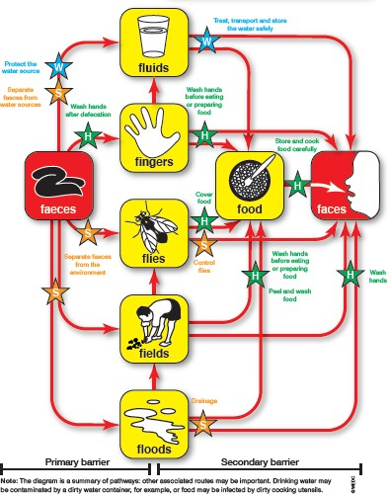
The «F-Diagram»
All key words are "F
From Faeces to Faces
Shows pathogen movement from faeces of a sick person to a potential new host
Different measures to prevent transmission
W = Water
S = Sanitation
H = Hand Hygiene
Source: Rod Shaw, WEDC

Slide 21
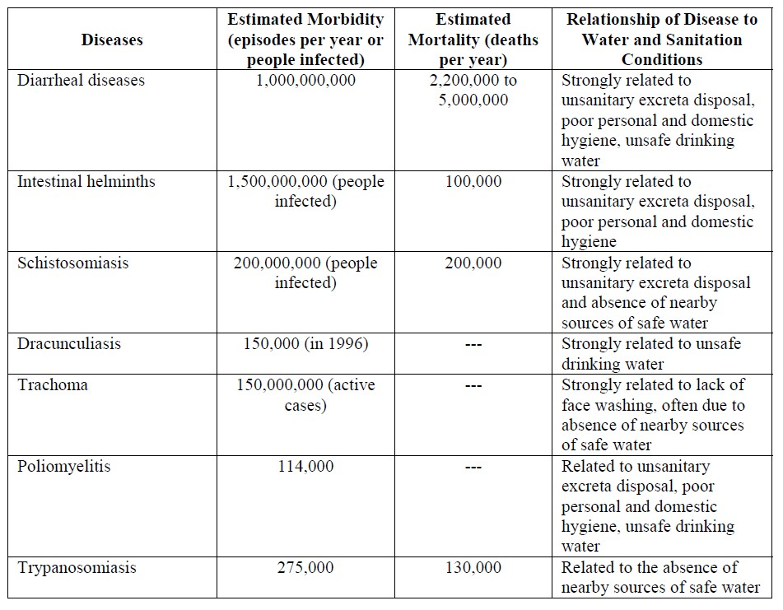
WASH & Public Health
Per year:
2.2 – 5 million deaths due to diarrhea
1.5 billion intestinal infections
Morbidity refers to illness or disease
Mortality refers to death
Source: The Pacific Institute

Slide 22
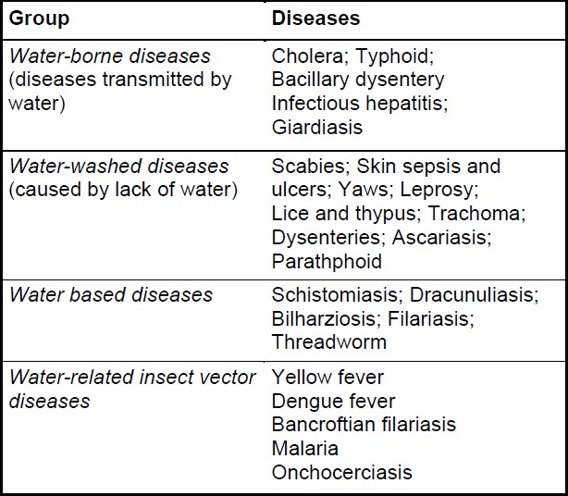
WASH & Public Health
4 different groups
Water-borne diseases most relevant to WASH interventions
Causing diarrhoea, which causes dehydration and malnutrion!
Source: World Health Organization

Slide 23
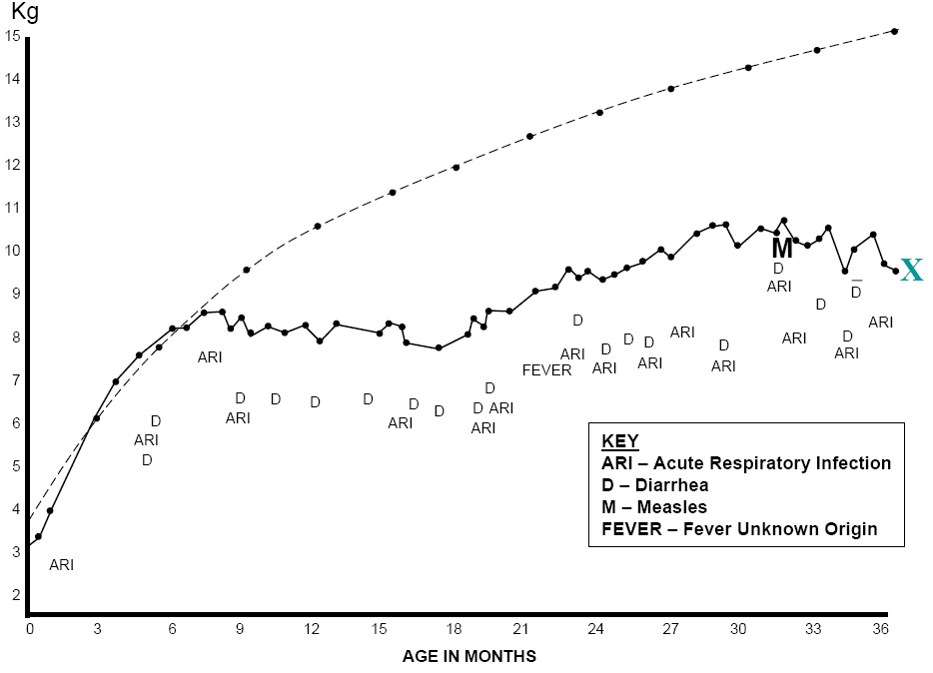
Barriers to disrupt transmission of disease
Laxmi‘s short life
Healthy child
Laxmi
Notes:
The graph illustrates the age-dependent development of the weight of a healthy child (dashed line) and of Laxmi – a child from a developing country (solid line). It demonstrates the accumulative burden of disease.
Figure: Laxmi’s short life. (Dooley, UNICEF Presentation, 2008)
Next slide:
What can increase the risk for diseases?
Additional information and questions:
It was not only one severe illness that caused Laxmi’s early death at the age of only three. During her entire life she had to fight one disease after another, among them acute respiratory infection, diarrhoea, measles, and fever. Due to her poor nutrition and health condition, she was affected by numerous infections that led to her early demise.
During an infection, health will be reduced and the person will become more vulnerable to further infections. What can a person do to break this vicious circle?
The graph of Laxmi’s short life shows a normal weight for the first six months, despite of several diseases. What factors lead then to the break-in? What are the effects of disease frequency?

Slide 24
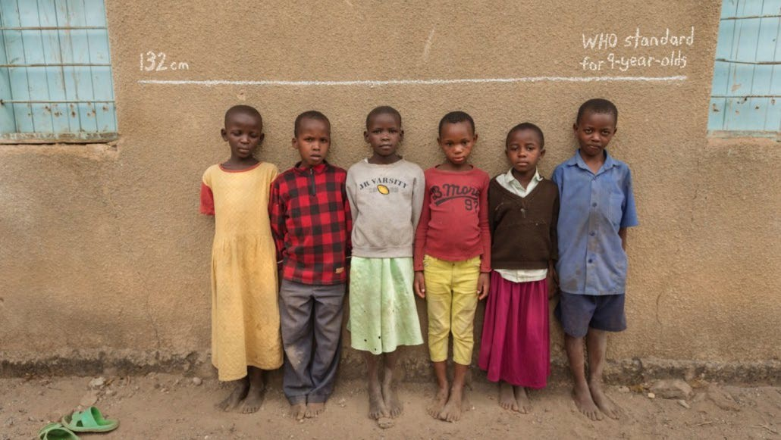
Visible Effect: Stunting
Source: World Health Organization

Slide 25
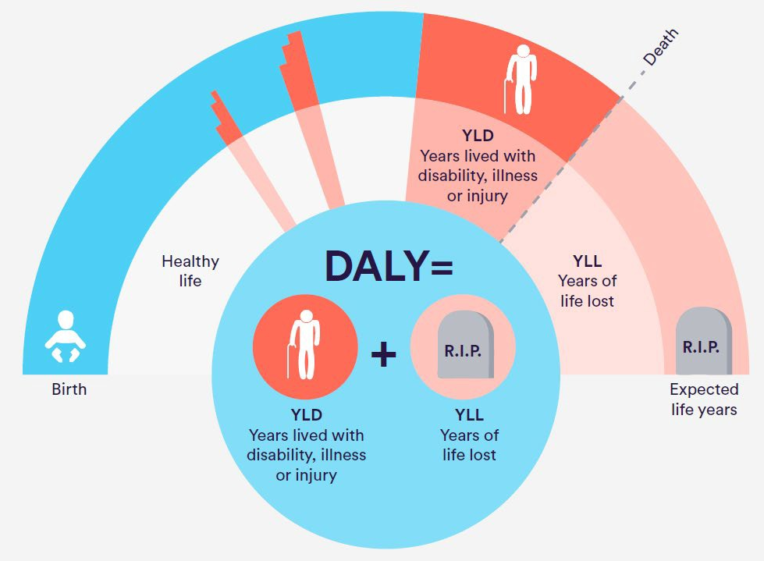
Invisible Effect: Disability Adjusted Life Years
https://epi.yale.edu/epi-results/2020/component/uwd
DALY = Disability Adjusted Life Years

Slide 26
Part III – WASH & the SDGs

Slide 27
WASH as a human right
Water, Sanitation & Hygiene (WASH) gained in pertinence:
2000: Millennium Development Goal (MDG) #7 includes a target sustainable access to safe drinking water and basic sanitation.
2010: The UN recognises WASH as basic human right.
2015: Dedicated Sustainable Development Goal (SDG) #6 on clean water and sanitation.
2000 – 2015: MDGs
2020
2015 – 2030: MDGs

Slide 28
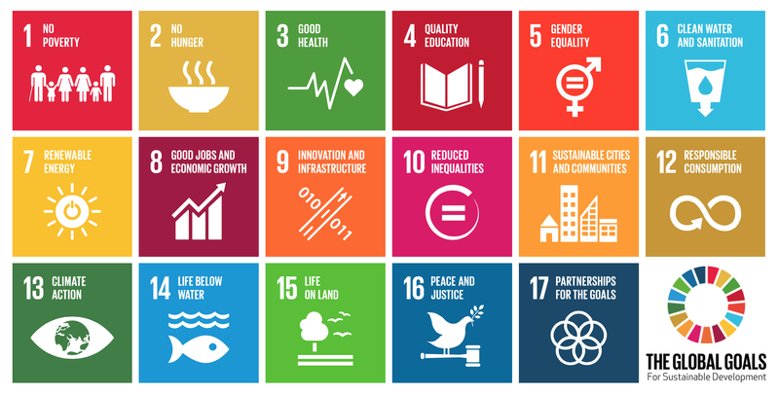
Sustainable Development Goals (SDGs)
17 goals
169 targets
232 global indicators

Slide 29
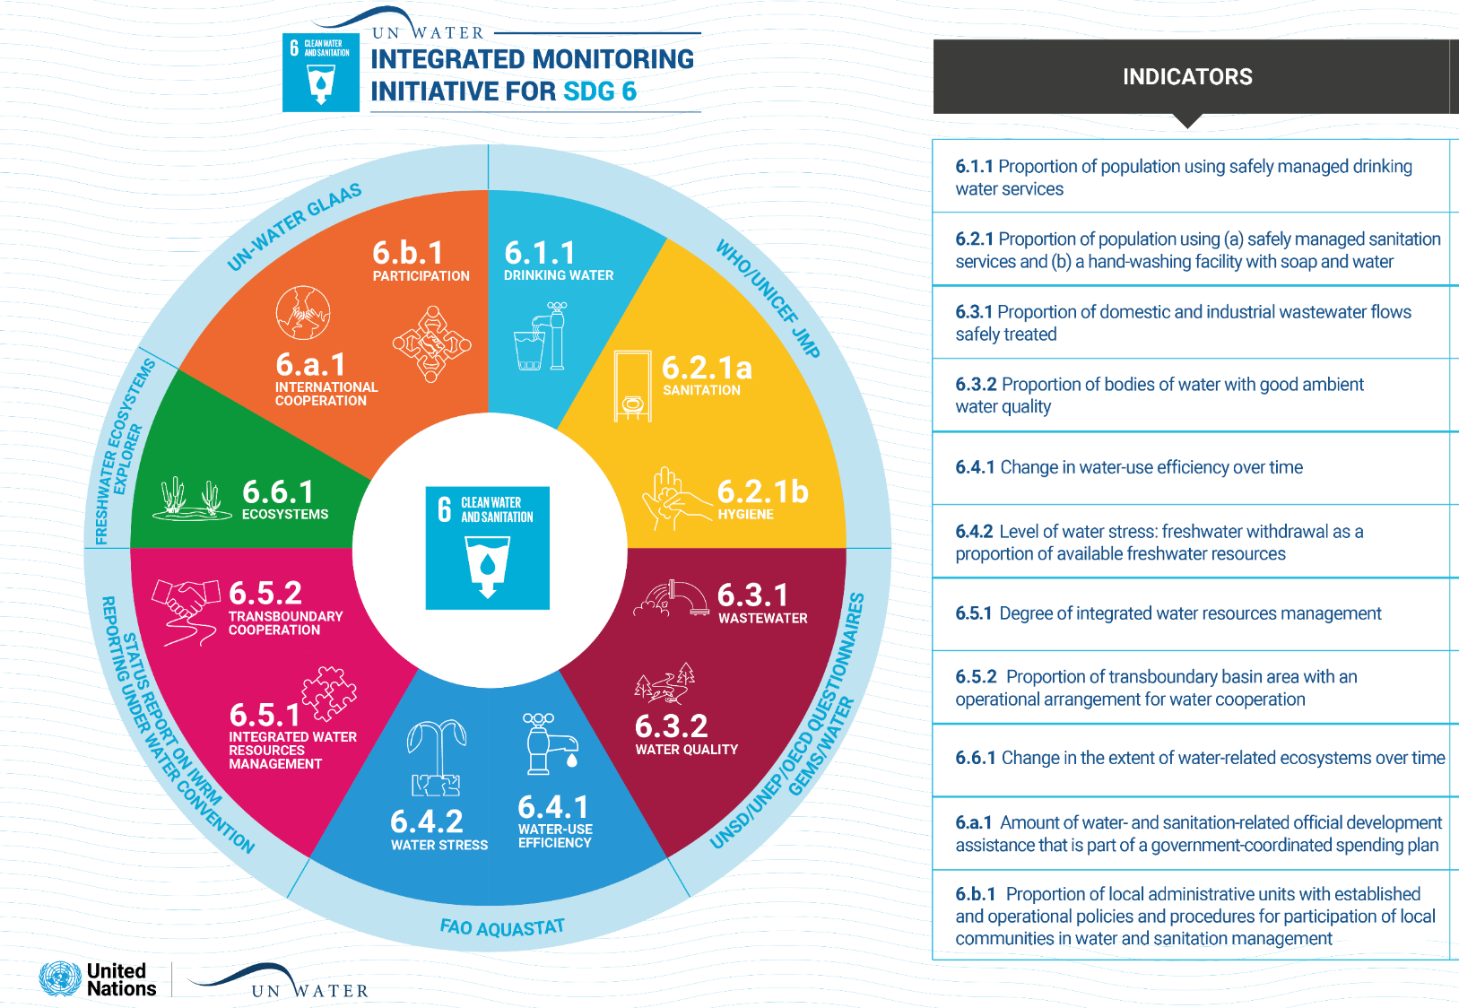
SDG #6

Slide 30
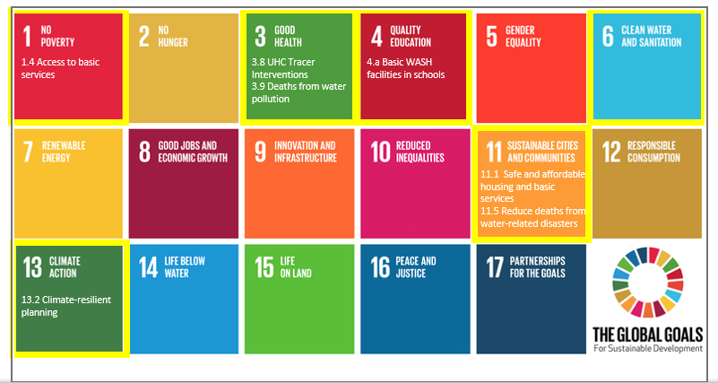
Sustainable Development Goals (SDGs)
Water linked to all SDGs
WASH linked to 7 other targets

Slide 31
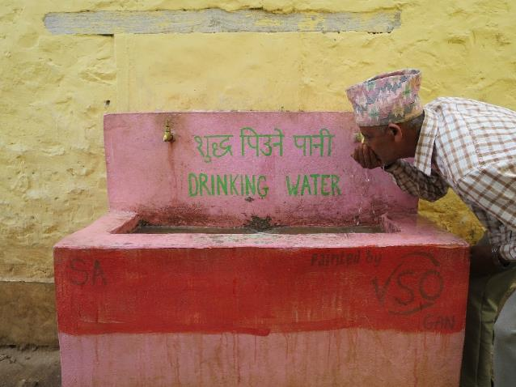
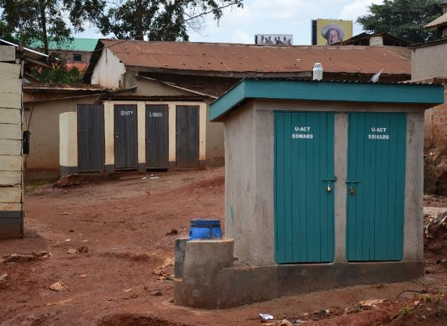
SDGs 6.1 and 6.2
6.1 Safely managed drinking water services
6.2 Safely managed sanitation services

Slide 32
Water service levels

Slide 33
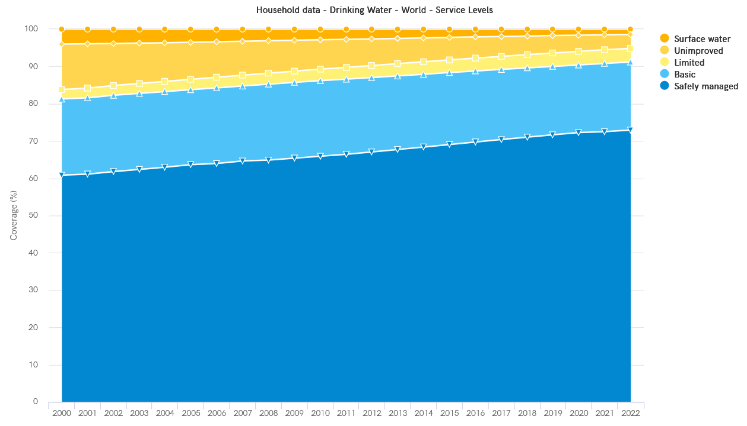
WATER
Access to safe water for households (2000- 2022)
73%
(WHO & UNICEF 2023)

Slide 34
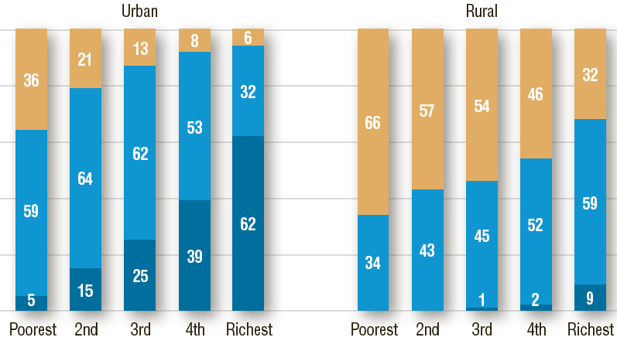
Inequity in water access

Slide 35
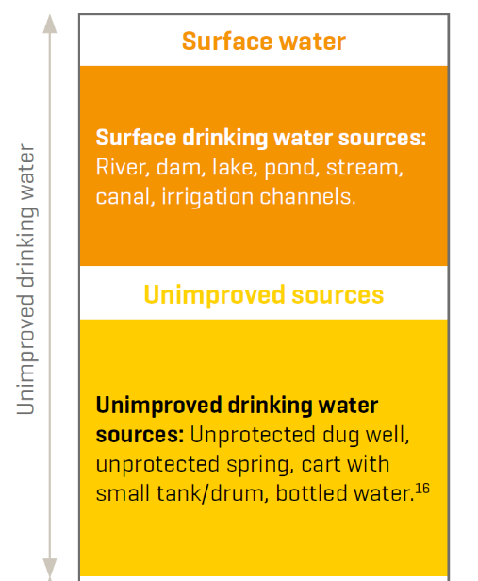
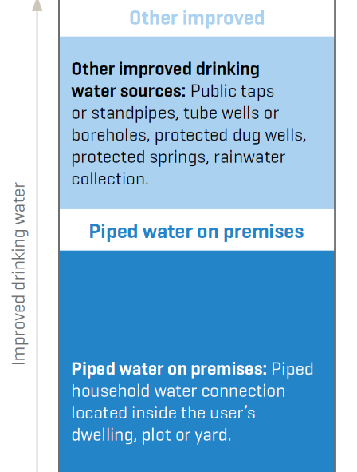
Improved sources for drinking water
(WHO & UNICEF 2015)

Slide 36
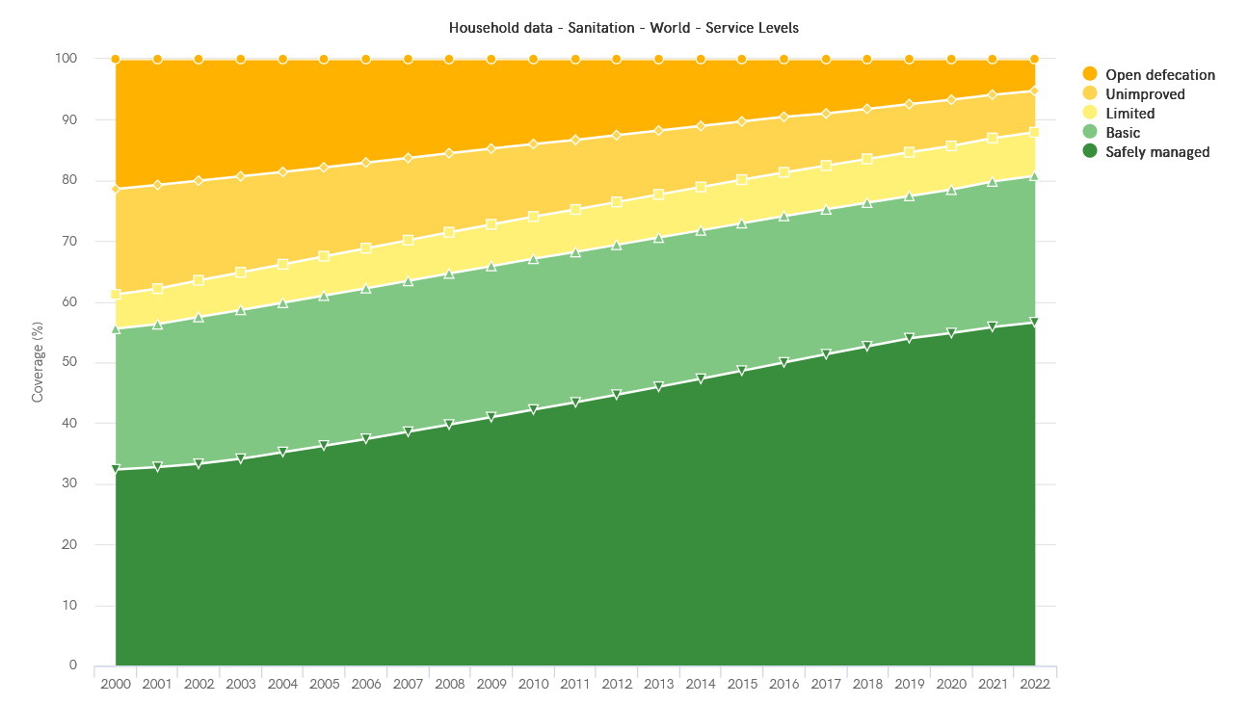
SANITATION
56%
56%
(WHO/UNICEF 2023)

Slide 37
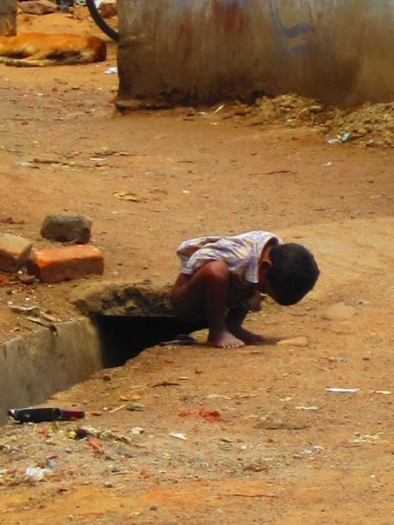
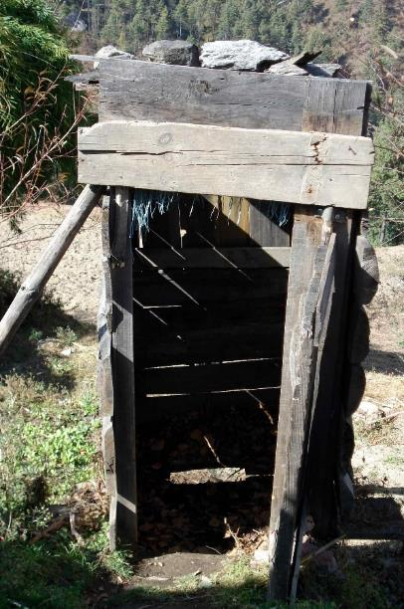
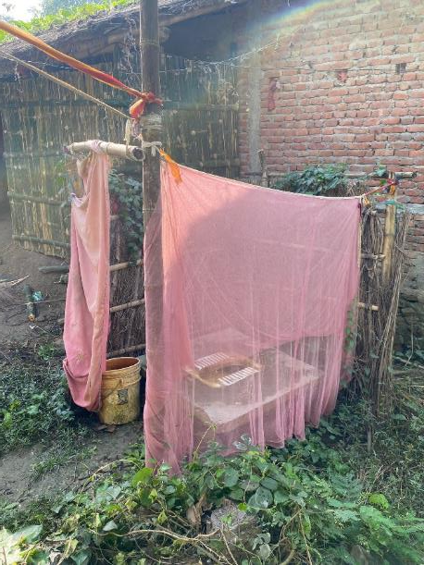
Examples unimproved sanitation

Slide 38
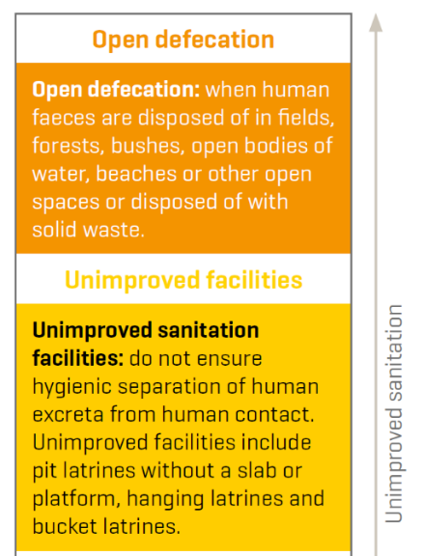
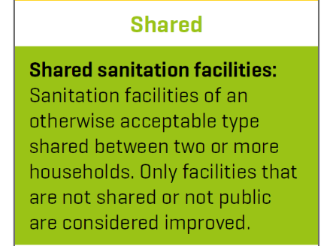
Sanitation service levels

Slide 39
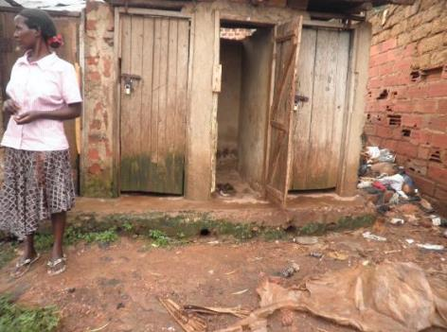
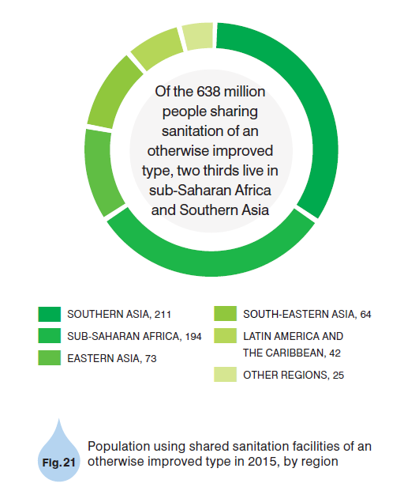
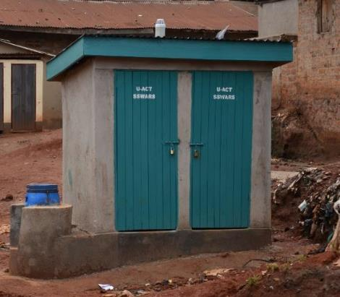
Shared sanitation
(WHO & UNICEF 2020)

Slide 40
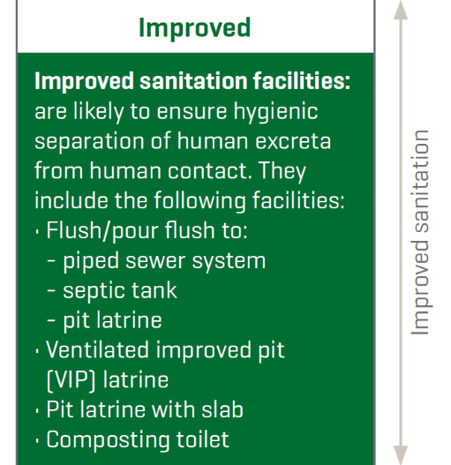
Improved sanitation

Slide 41
Part IV – Semester Group Work

Slide 42
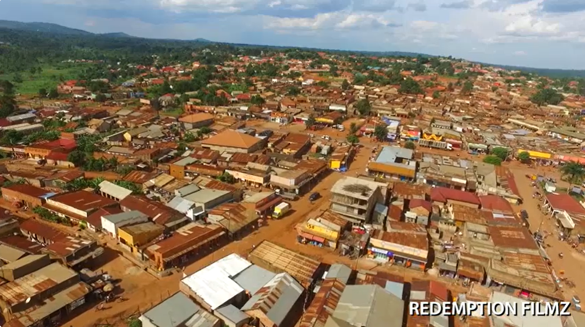
Case Study: Wobulenzi, Uganda

Slide 43
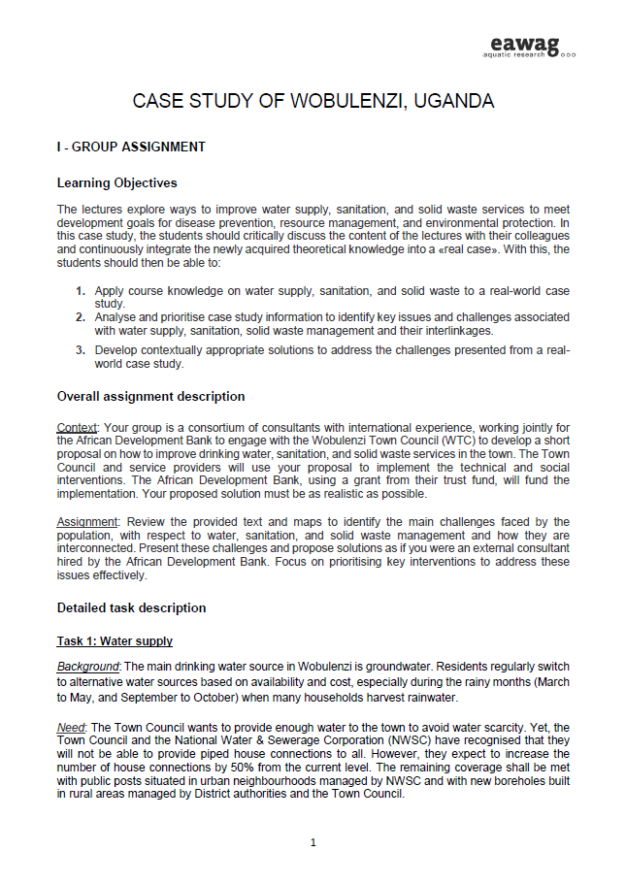
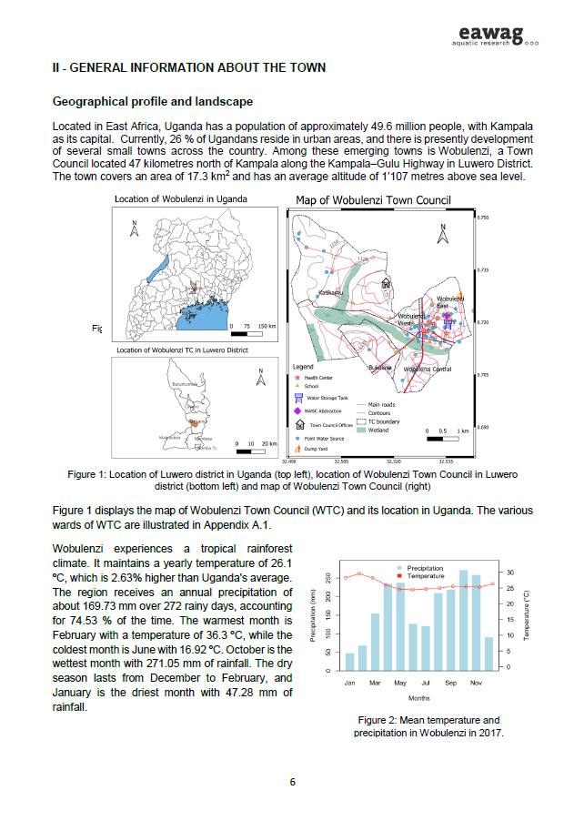
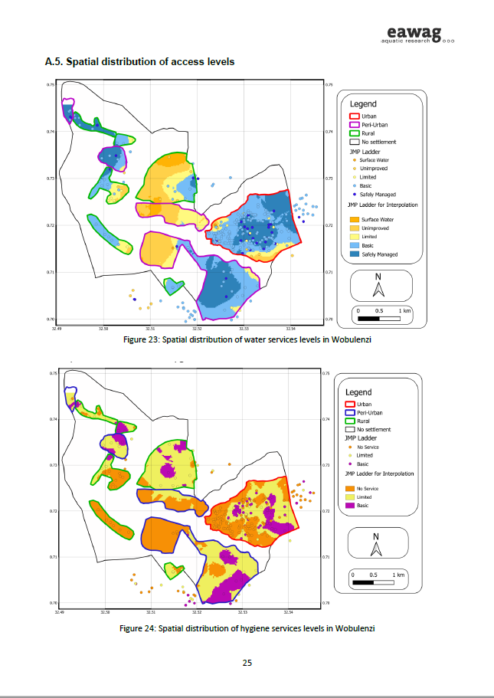
Group assignment: Handout
General assignment overview
Background info on Wobulenzi
Sectorial analysis:
Water supply
Sanitation
Solid waste management
Interlinkages
Appendix
Maps
Flow diagrams

Slide 44
Tasks
Develop a decentralized water access and distribution approach (treatment & sales) for the project area
Design a small-scale sanitation solution for the project area
Develop a business and operational plan for a small enterprise to manage solid waste in this community
Critically reflect on the limitations of the proposed solutions in task 1-3 and discuss the possibility of combining some solutions into an integrated system

Slide 45
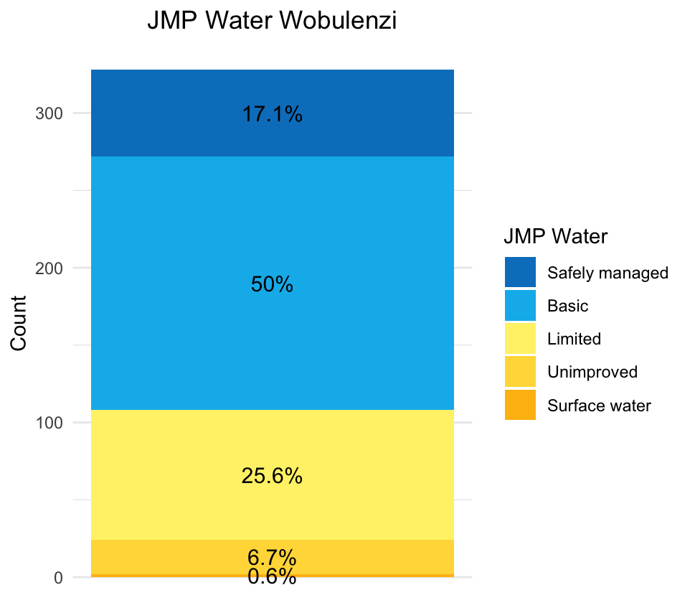
Water supply
Water Service Access:
Piped water: 44.2%
Yard connections: 22.6%
PSPs: 21.6%
Half of households have basic service
Regular supply interruptions
Inadequate chlorine dosing → E. coli contamination
Dirty storage containers → Recon-tamination!
Water JMP Ladder

Slide 46
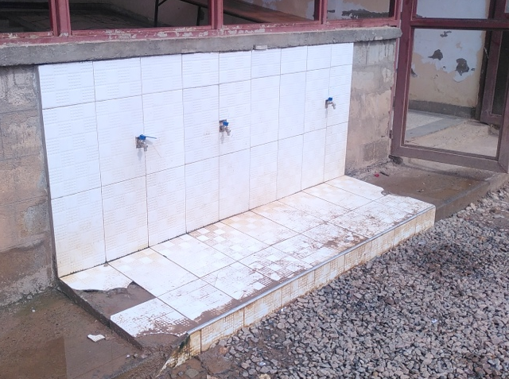
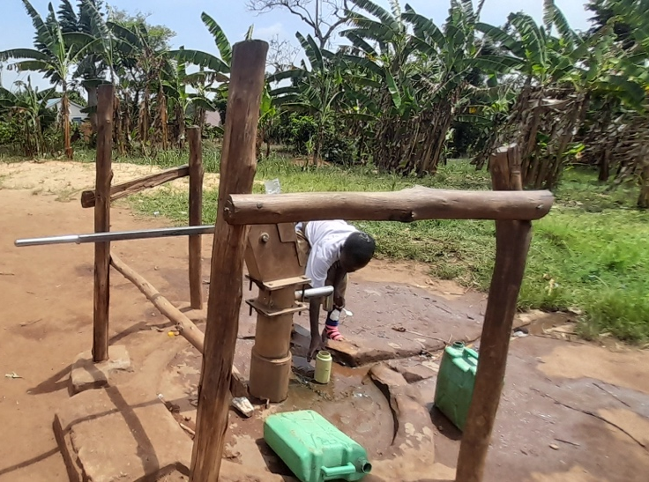
Water supply
Public Stand Pipes (PSPs) with taps
Water from borehole with a pump

Slide 47

Sanitation
Simple pit latrines
predominant sanitation facility
are unlined and only 22% are fully lined
Limited emptying services: only 3% emptied
Underutilized Faecal Sludge Treatment Plant (FSTP)
Sanitation JMP Ladder

Slide 48


Sanitation
Simple pit latrine
Very clean pour flush toilet

Slide 49

Hygiene
Handwashing Facilities
Lacking for 53% of households
Mostly functional where available
Hygiene JMP Ladder

Slide 50

Solid Waste Management
Relies on informal and formal waste collection
Waste disposed in uncontrolled dumpsites: Open dumping & burning
Collection workers face irregular payment
Collection trucks in poor condition
Waste collection truck

Slide 51

Solid Waste Management
High segregation of kitchen waste, recyclables, and garden waste
Informal junk buyers purchase recyclable items from households
PET is the most separated recycled material by households
Informal PET collection

Slide 52

Negative interlinkages
Disposal of solid waste into pits, water bodies, or stormwater drains
Animal interaction with sanitation facilities and water storage
Drinking water contamination by:
Leaks from sanitation containers
Poor hygiene practices
Landfill leachate: Nearby water source contamination
Animal grazing in a landfill

Slide 53

Positive interlinkages
Greywater reuse for:
cleaning
toilet flushing
garden irrigation
animal feeding
On-site composting for:
nutrient recovery
recycling of materials from the solid waste stream
Agriculture site in Abuville

Slide 54
Expected outputs, grading & next steps
4 tasks to be completed
1 report (max. 13 pages, Arial 10, single lined).
Final grade:
Exam 70%
Group work 30%
Form groups of 5 students
One group member communicates members + student ID# to me
Each week your group meets to discuss and work on proposal
Hand in final report by 12th December 2024 as pdf file

Slide 55
Learning goals
Apply course knowledge on water supply, sanitation, and solid waste to a real-world case study.
Analyse and prioritise case study information to identify key issues and challenges associated with water supply, sanitation, solid waste management and their interlinkages.
Develop contextually appropriate solutions to address the challenges presented from a real-world case study.

Slide 56






Key resources
Sanitation Compendium (2014)
Water
Compendium (2022)
Global Report on Sanitation & Wastewater Management (2023)
Faecal Sludge Management (2014)
Rural Community Water Supply (2021)
Why shit matters > TEDx talk

Slide 57

Questions

Slide 58

Herzlichen Dank !
Merci bien
Thanks a lot!

